Slide 1
Lecture 05 BFS / DFS / Shortest paths problem
Spring 2026
Zhihua Jiang

Slide 2
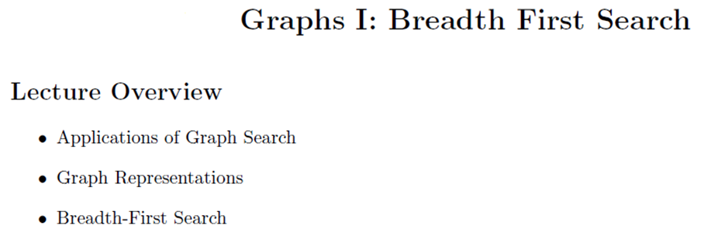

Slide 3
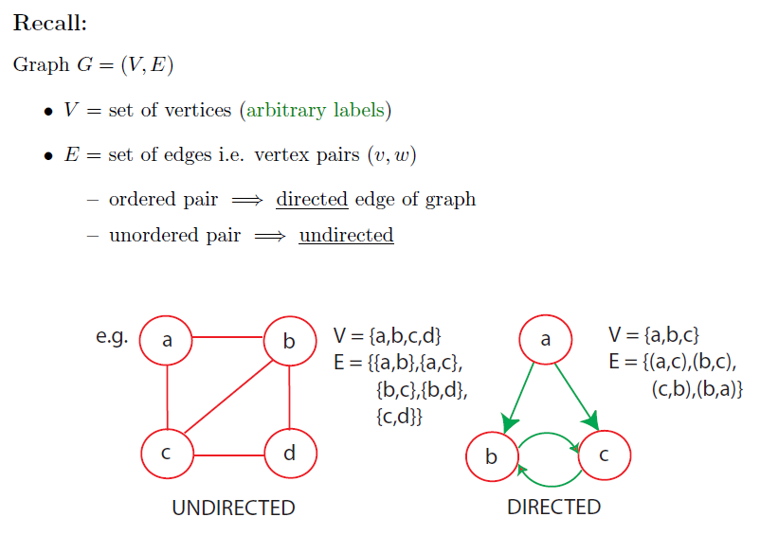

Slide 4
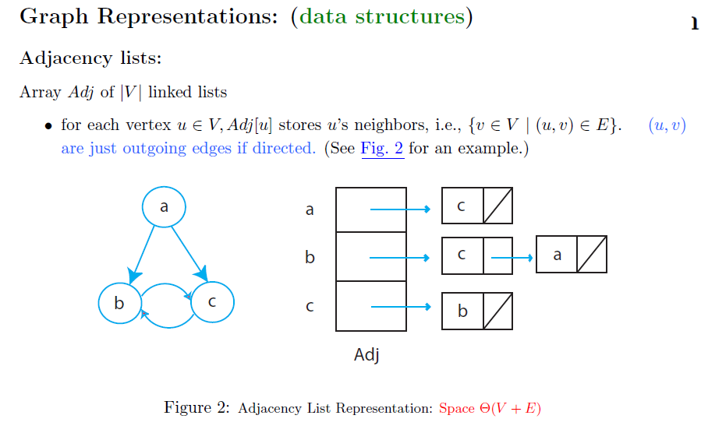
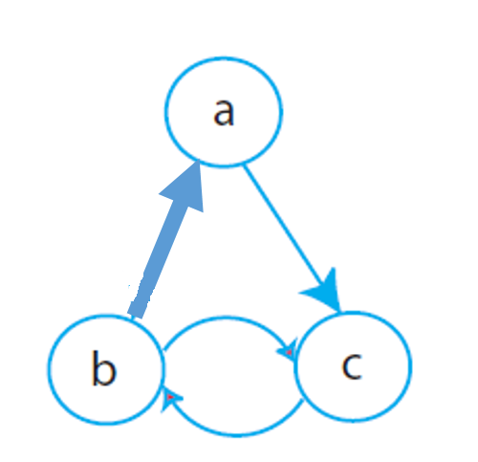

Slide 5
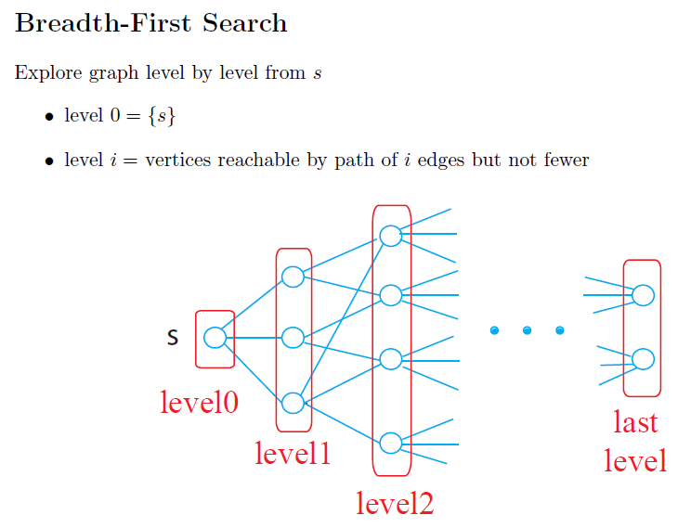

Slide 6
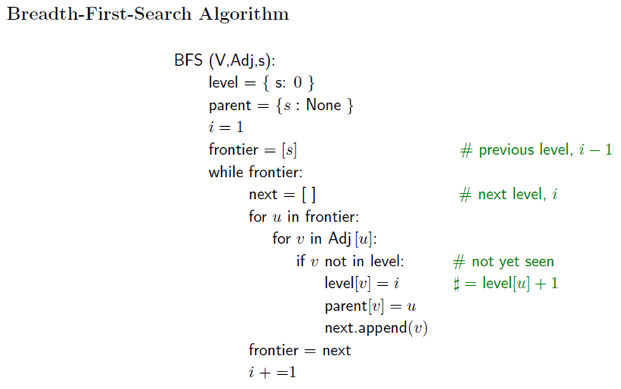

Slide 7
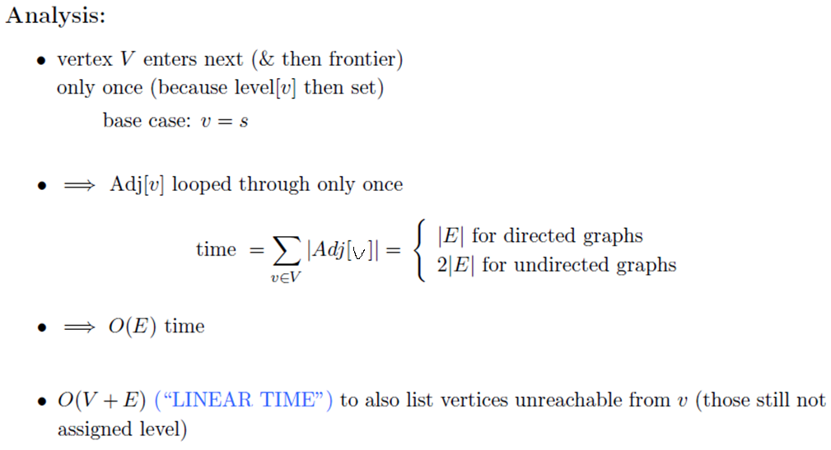

Slide 8
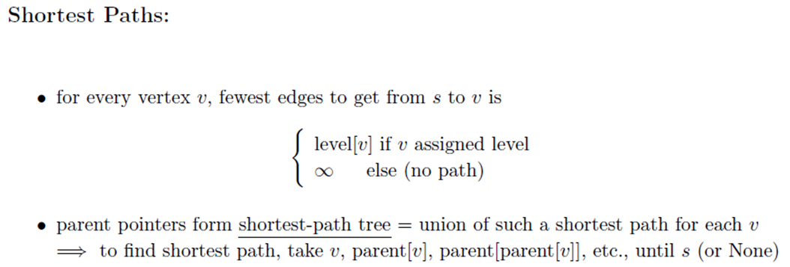

Slide 9
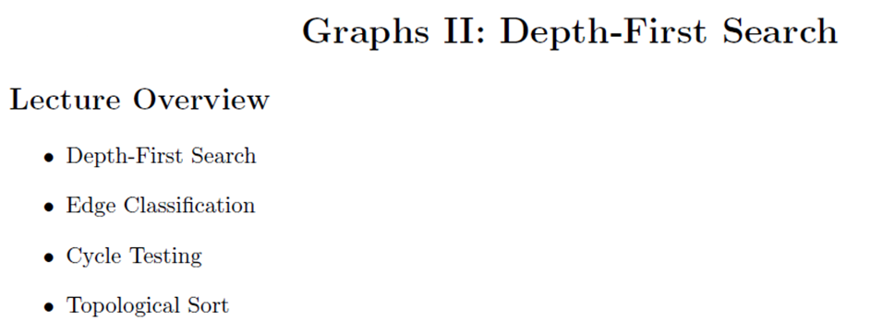

Slide 10

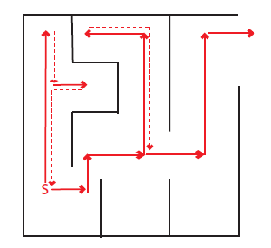


Slide 11
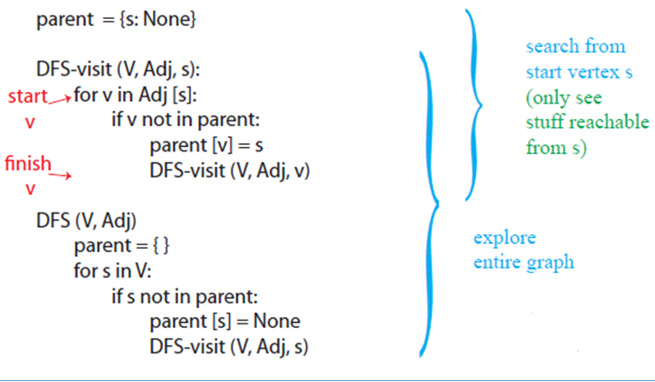


Slide 12
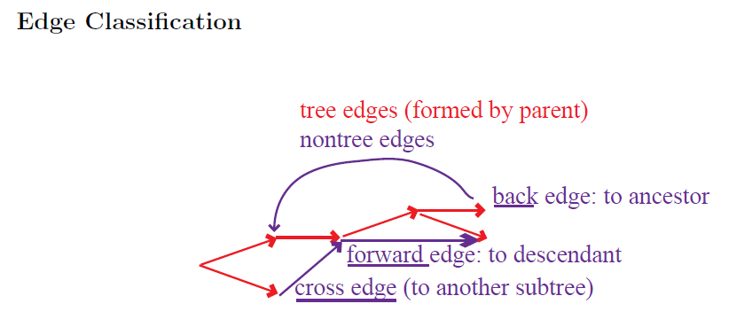


Slide 13
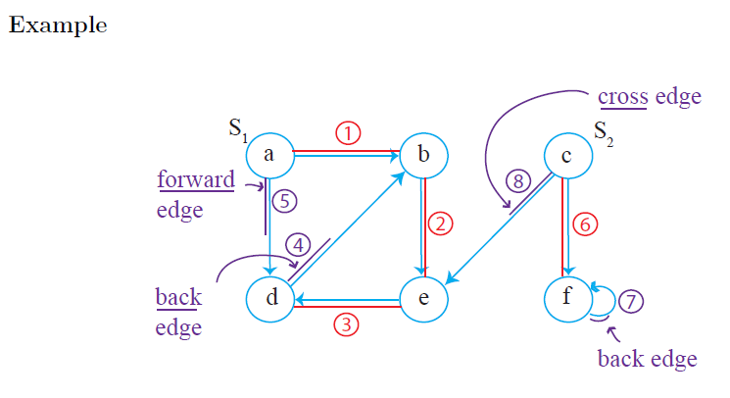

Slide 14

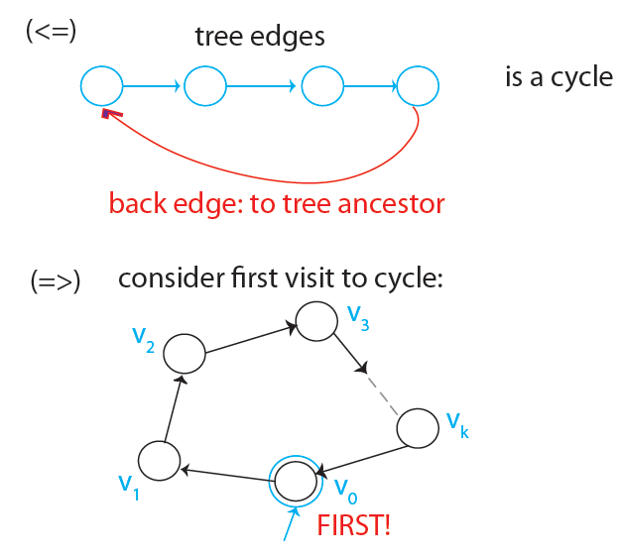
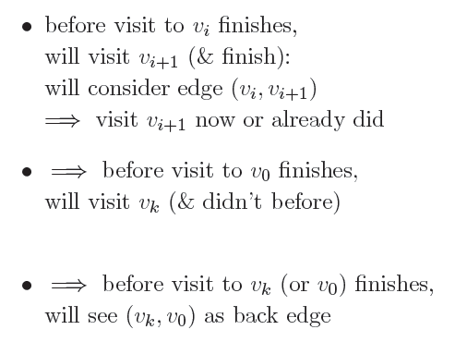
Notes:
V0: the first vertex in the cycle visited by DFS
Start v0, start vk, finish vk, finish vk – balance.

Slide 15


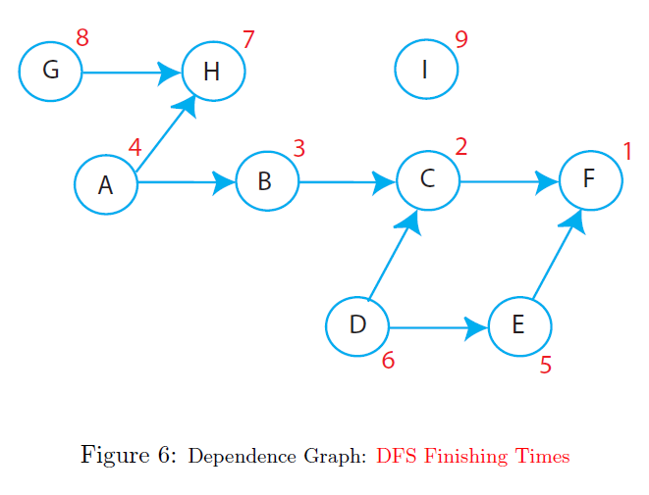

Slide 16


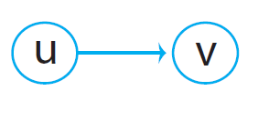

Slide 17
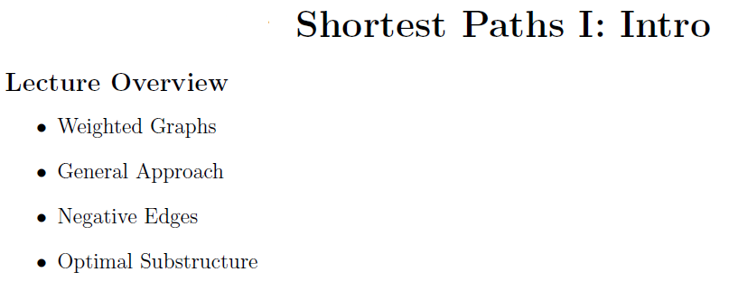

Slide 18

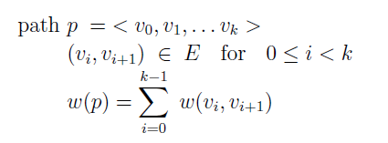

Slide 19
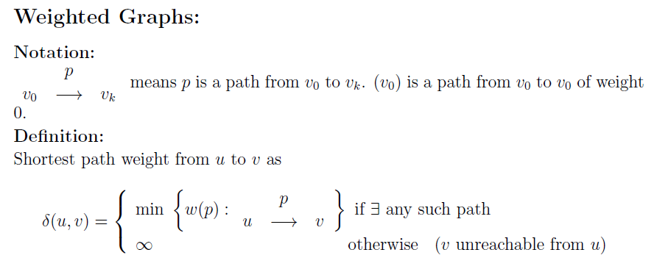

Slide 20
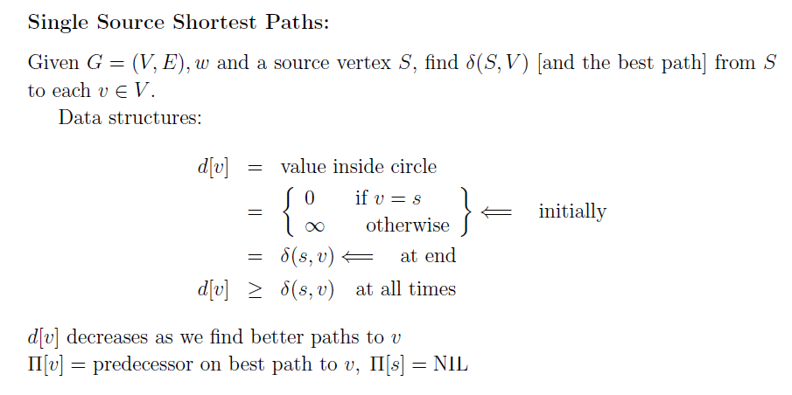

Slide 21
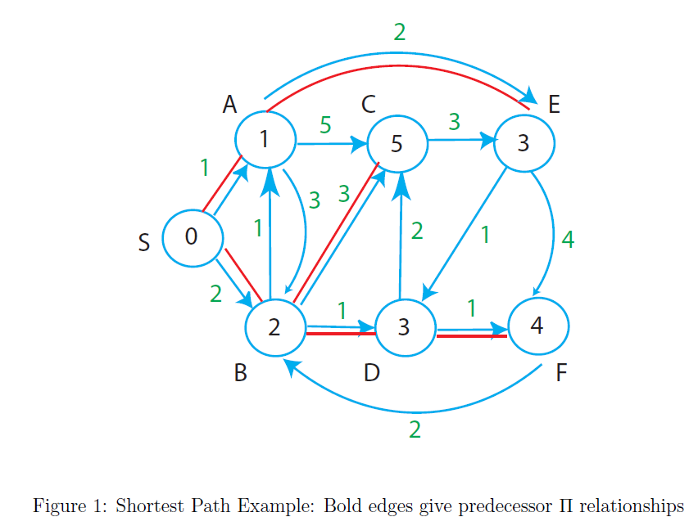

Slide 22

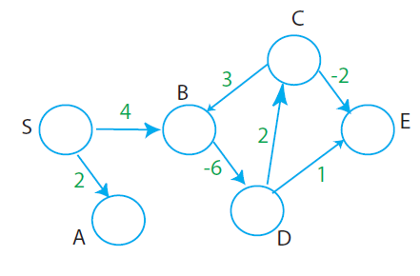

Notes:
Negative cycle: D-C-B
SP undefined: in or reachable by negative cycle

Slide 23
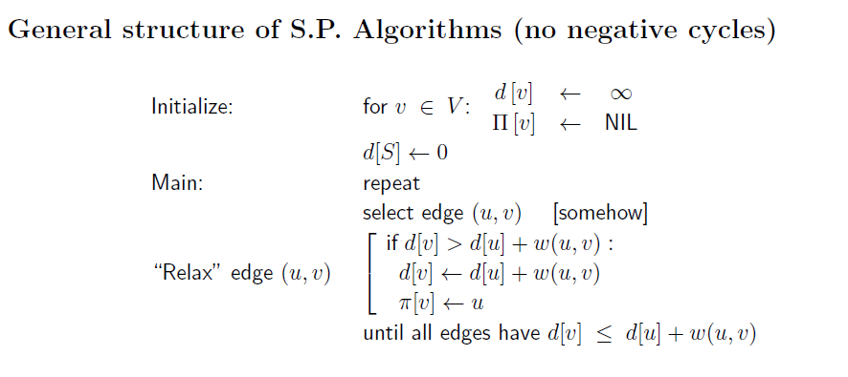

Slide 24


Notes:
Cut and copy

Slide 25
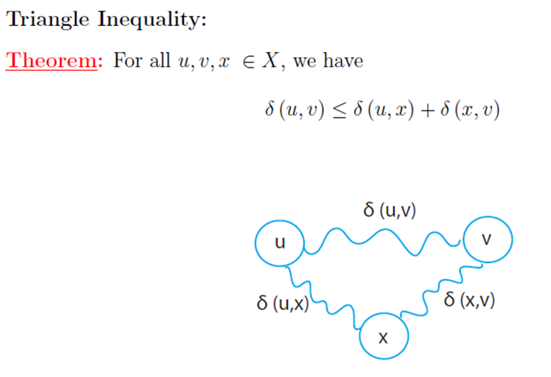

Slide 26
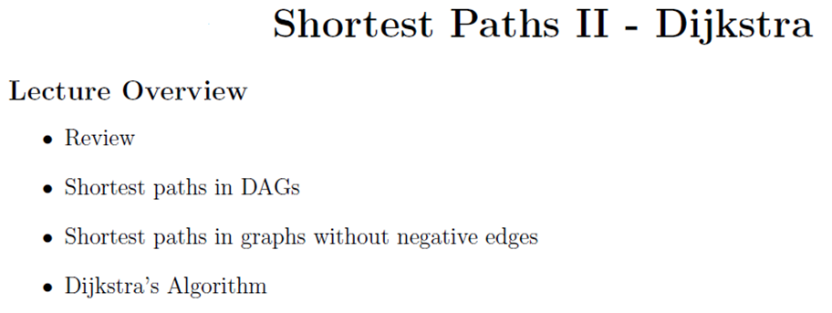

Slide 27


Slide 28

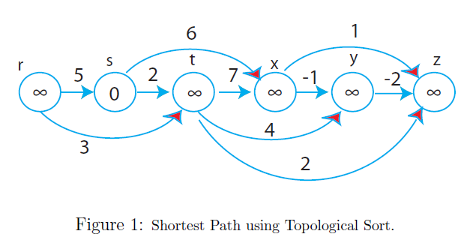
Can deal with negative edges

Slide 29

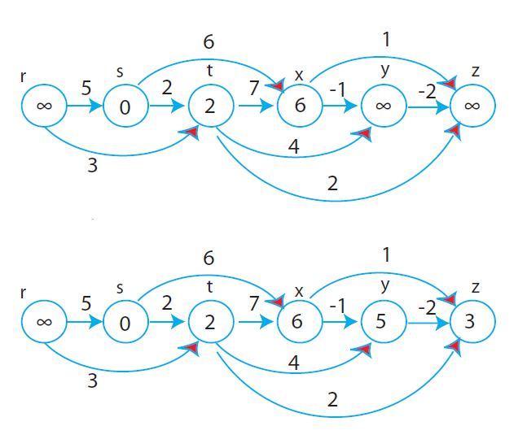


Slide 30
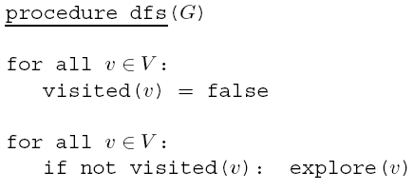
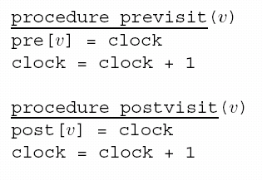

Slide 31
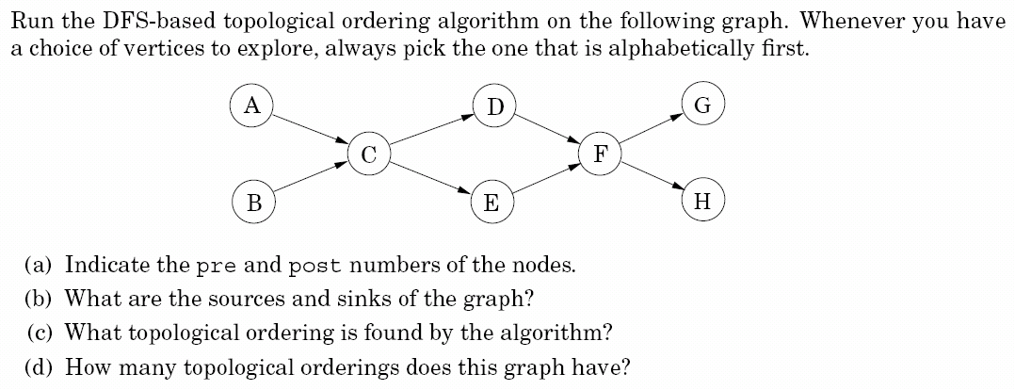
Notes:
Pre: first visit time
Post: final departure time

Slide 32
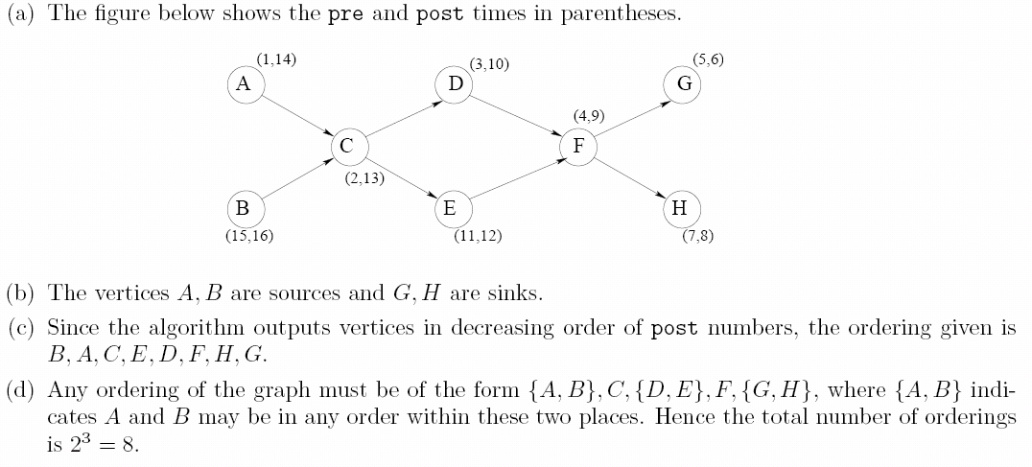

Slide 33
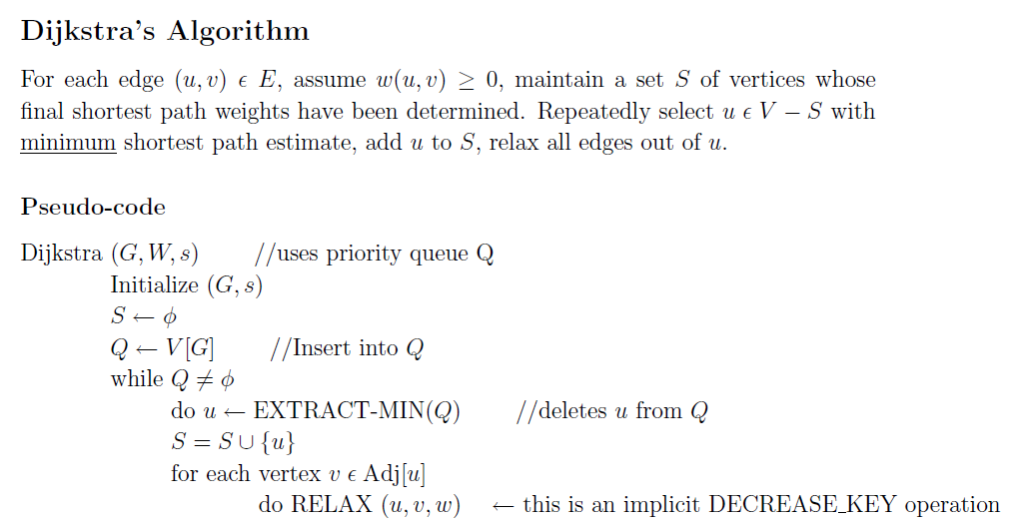

Slide 34
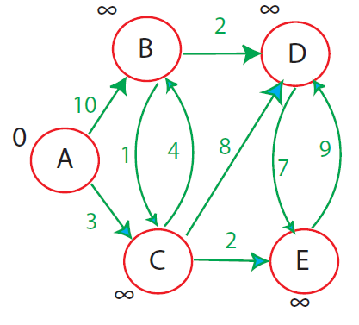
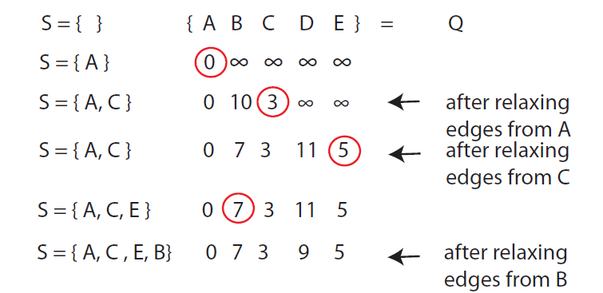

Slide 35



Slide 36
Priority queue implementations
The running time of Dijkstra’s algorithm depends heavily on the priority queue implementation.
36

Slide 37
d-ary heap
Identical to a binary heap, except that nodes have d children.
The height of the tree:
Insert/DecreaseKey: speeded up,
DeleteMin: take a longer time,
Total: |V|DeleteMin+|V|Insert+|E|DecreaseKey
Notes:
Insert: swap(parent, inserted item)
Deletemin/decreasekey: swap(parent, smallest child)

Slide 38

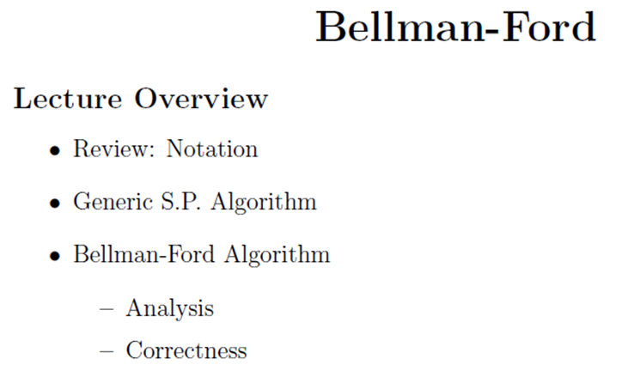

Slide 39
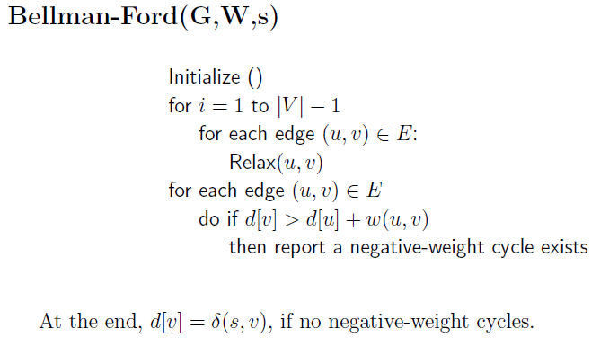


Notes:
Corollary 英 [kəˈrɒləri]

Slide 40
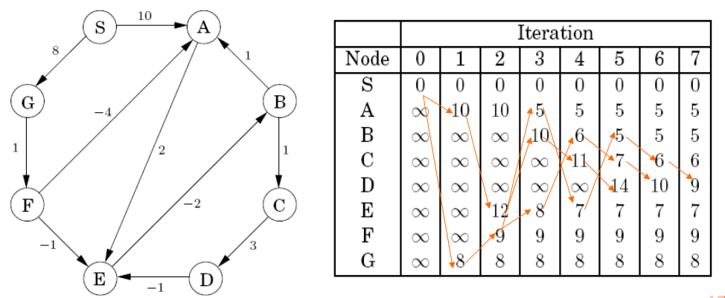

Slide 41


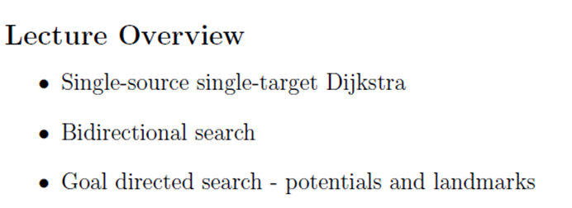

Slide 42
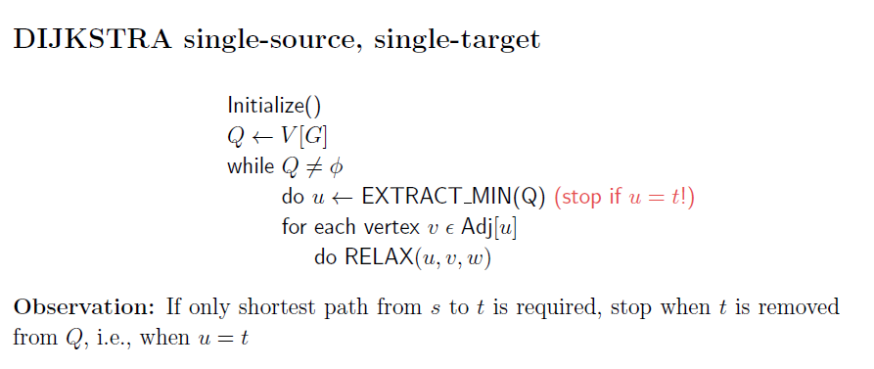

Slide 43

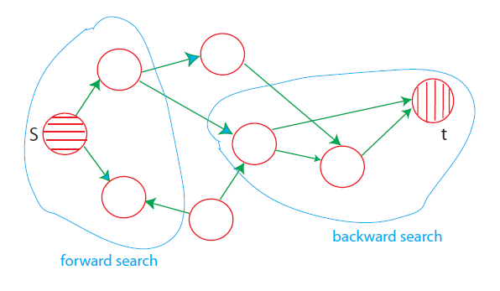

Slide 44
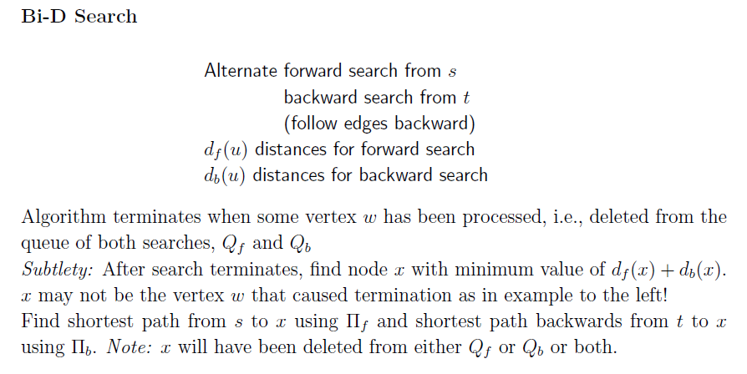

Slide 45

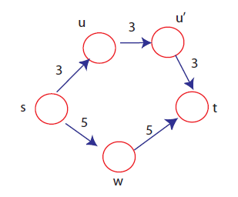

Slide 46
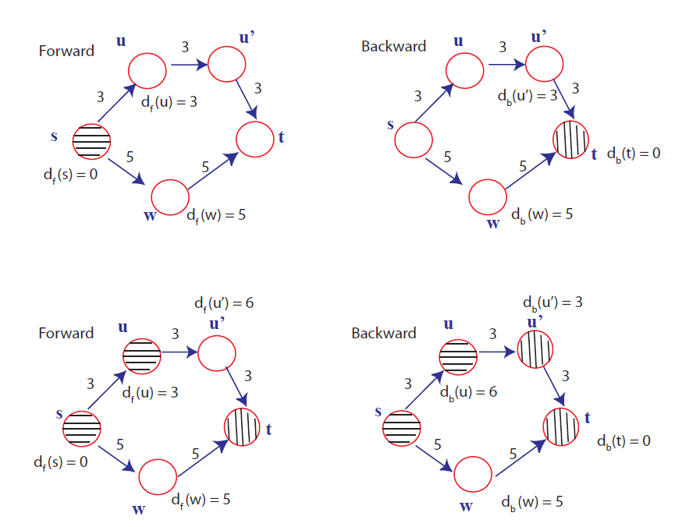

Slide 47
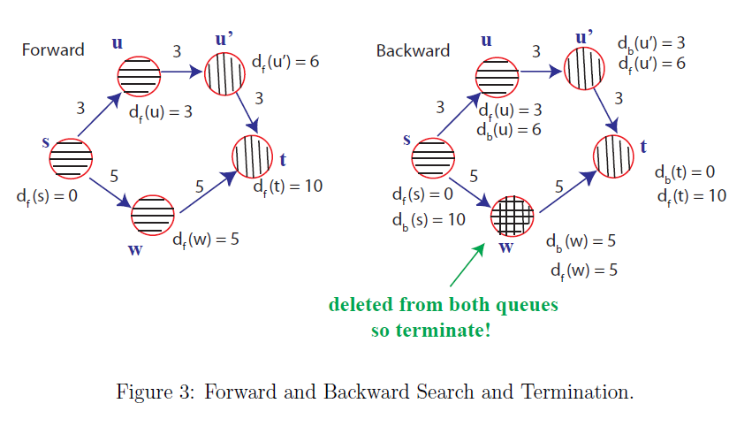
Notes:
The alg dominated regarding to the length not to the weight. Shortest length path not equal to shortest weight path.

Slide 48

Exercise

Slide 49



Slide 50
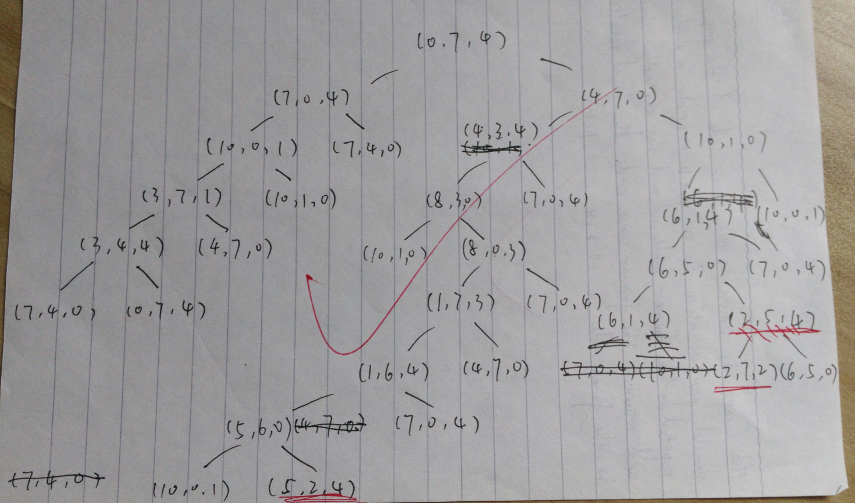
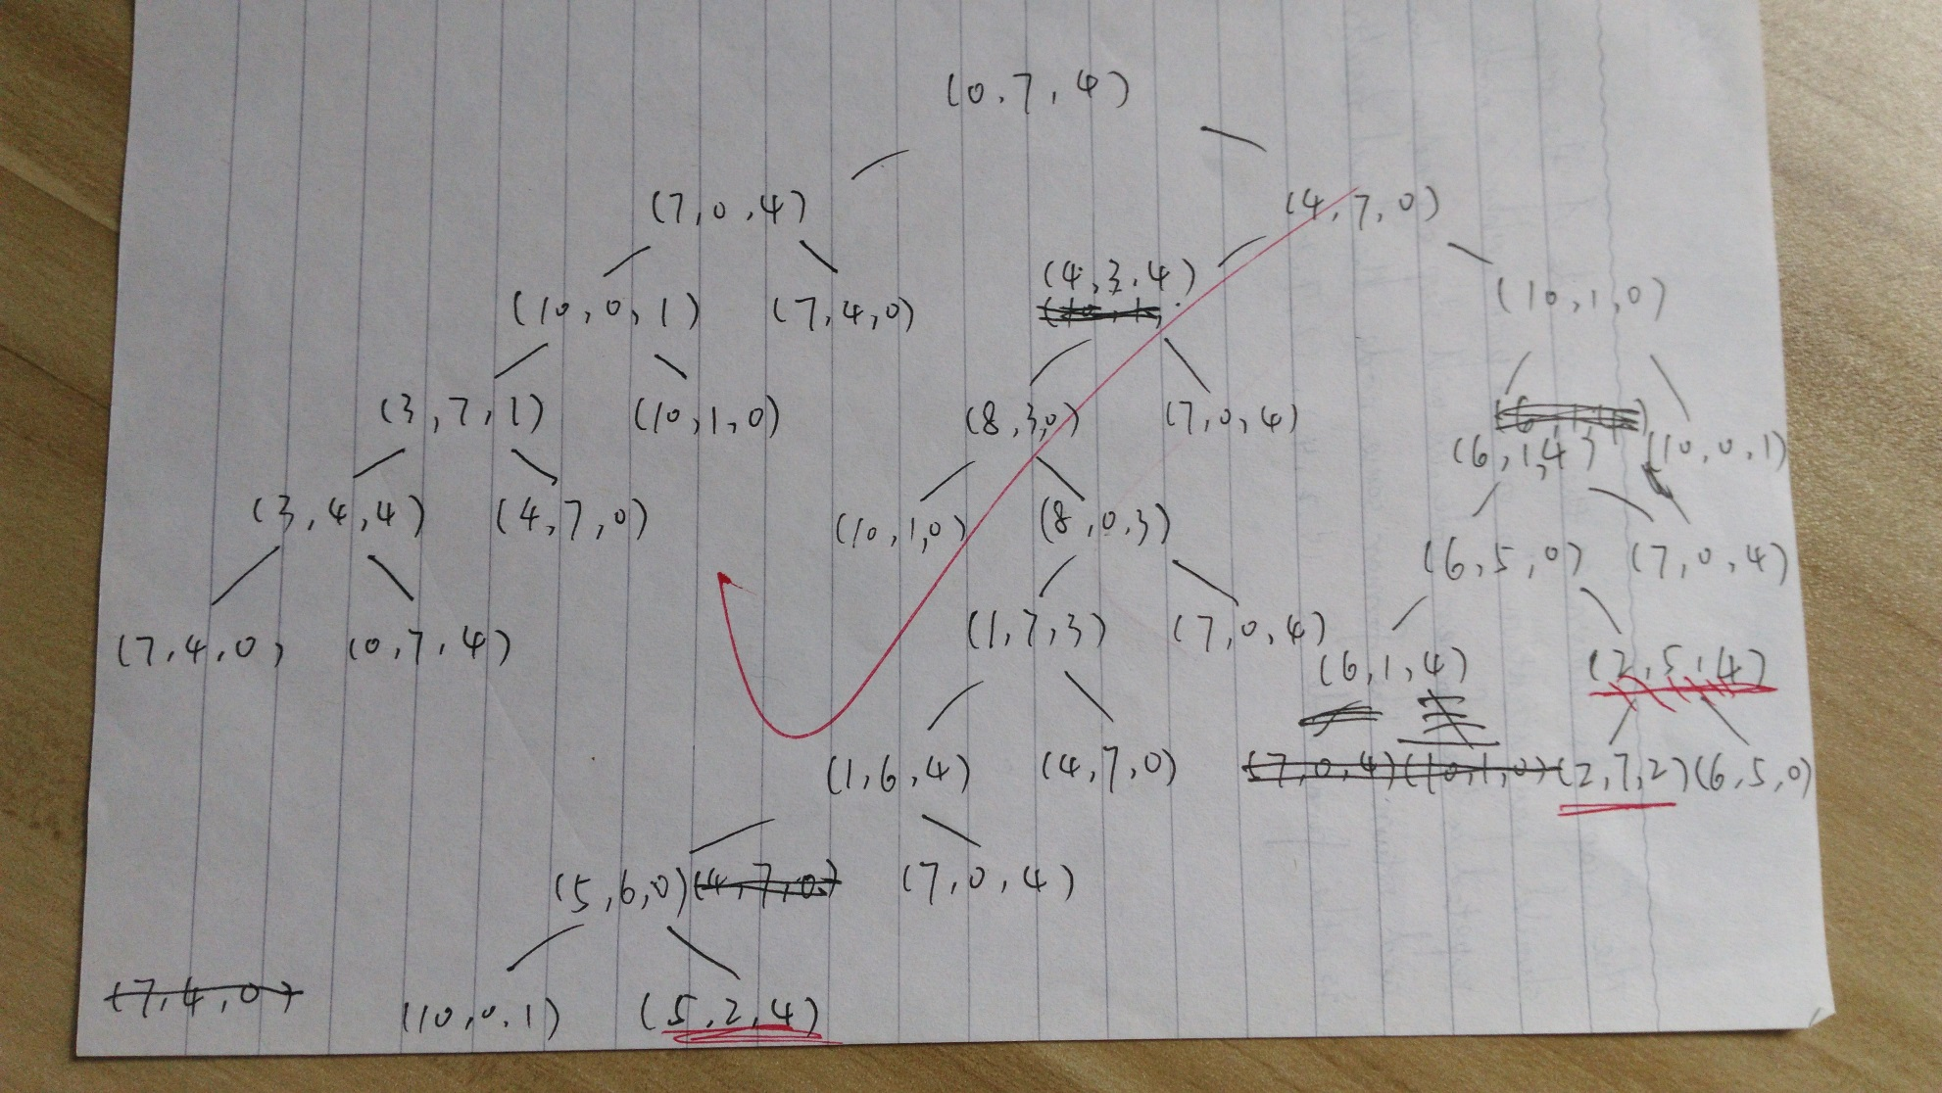

Slide 51
